Slide 1
Discussion of Private College Enrollment Trends for 2023 and Beyond
Private College Advisory Board Meeting
May 15, 2023
Peter Blake, Director

Slide 2
Agenda for today
Identify statewide private, nonprofit enrollment trends
Describe what we know about admissions and inter-state enrollment
Update PCAB on Council policy considerations
Seek feedback from PCAB on trends and projections

Slide 3
Enrollment trends

Slide 4
Total Virginia Institution Fall Enrollment by Sector, 1992-2022
Source: SCHEV E03 Report.
Notes:
Two-year data include dual enrollment.100K dual enrollment

Slide 5
Fall Enrollment by Domicile at Private Nonprofit Institutions, 1992-2022
Source: SCHEV E03 Report.

Slide 6
First Time in College, In-State Four-Year Enrollment: 2016-2022
Institution | 2016 | 2017 | 2018 | 2019 | 2020 | 2021 | 2022
Public –Total Percent FTIC | 27,243 (84%) | 28,210 (86%) | 28,488 (85%) | 28,673 (89%) | 27,093 (86%) | 26,521 (87%) | 28,049 (86%)
Private –Total Percent FTIC | 5,747 (16%) | 5,512 (14%) | 5,994 (15%) | 5,842 (11%) | 5,522 (14%) | 5,372 (13%) | 5,631 (14%)
Source: SCHEV E02 Report.

Slide 7
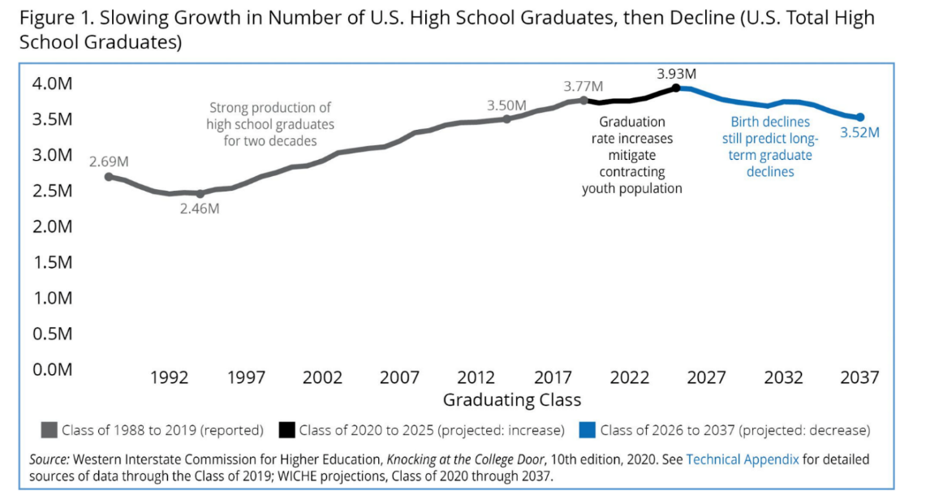
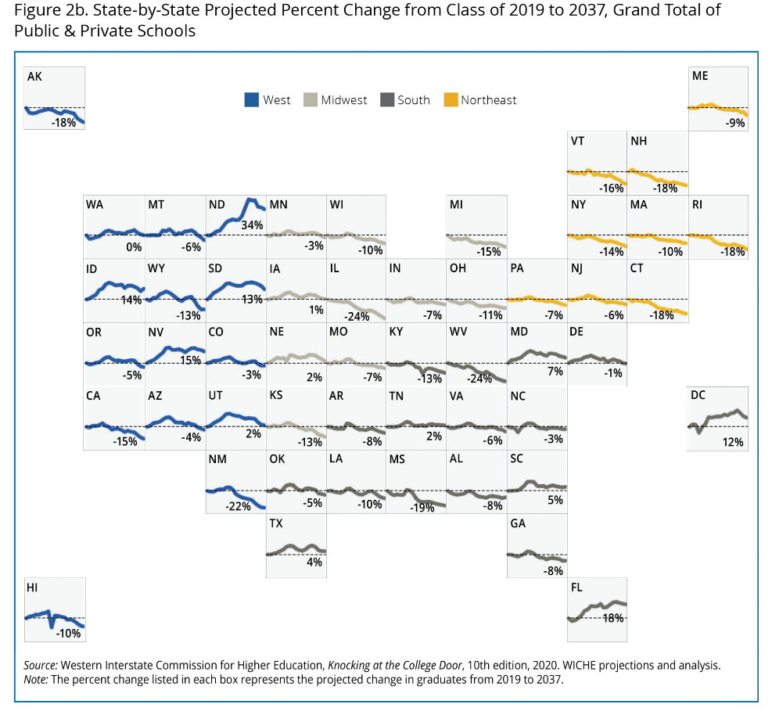
National High School Graduate Projections
In all states the decline of high-school graduates from affluent families is projected to be higher than the overall decline. It is the affluent students who are sought after by universities as they recruit out-of-state students.
Notes:
These projections are used widely across a wide range of education stakeholders from policymakers to enrollment managers at the institutional level for short- and long-term planning in terms of capacity building and understanding who their future high school graduates are on college campuses.

Slide 8
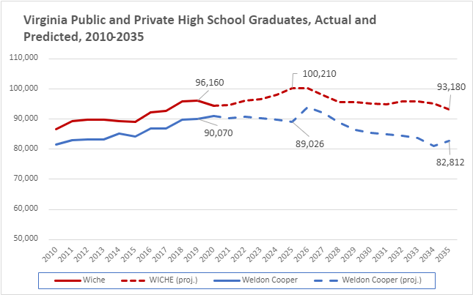
Actual and Predicted Virginia High School Graduates
In all states, including Virginia, the decline of high-school graduates from affluent families is projected to be higher than the overall decline. It is the affluent students who are sought after by universities as they recruit out-of-state students.
Sources: Western Interstate Commission for Higher Education, Knocking at the College Door: Projections of High School Graduates, 2020.
WICHE includes private high school graduates. Weldon Cooper only includes public high school graduates.
Notes:
These projections are used widely across a wide range of education stakeholders from policymakers to enrollment managers at the institutional level for short- and long-term planning in terms of capacity building and understanding who their future high school graduates are on college campuses.
WICHE proves to under predict Virginia numbers.
WC does not include private high schools.

Slide 9
College Non-Enrollment Rate – High School Graduates
Source: VDOE C11 Report. Non-enrollment are graduates of Virginia high schools who did not enroll in a post-secondary program within 16 months.
Notes:
Far right timeline is actually 2020

Slide 10
Projections of HS to College Pipeline
Notes:
Sources: Western Interstate Commission for Higher Education, Knocking at the College Door: Projections of High School Graduates, 2020
WICHE includes private high school graduates. Weldon Cooper only includes public high school graduates.

Slide 11
Admissions and inter-state enrollment

Slide 12
Private Nonprofit Admissions Report 2012-2021
Four-Year, Private Nonprofit Institutions
Excluding Liberty University
Liberty University
Year | Acceptance Rate | Yield Rate | FTIC Cohort, First Year Retention Rate
2012-13 | 67% | 20% | 73%
2013-14 | 69% | 22% | 73%
2014-15 | 66% | 19% | 74%
2015-16 | 70% | 19% | 76%
2016-17 | 69% | 19% | 75%
2017-18 | 66% | 19% | 74%
2018-19 | 69% | 17% | 74%
2019-20 | 71% | 16% | 75%
2020-21 | 69% | 15% | 76%
2021-22 | 68% | 18% | 74%
Year | Acceptance Rate | Yield Rate | FTIC Cohort, First Year Retention Rate
2012-13 | 27% | 47% | 69%
2013-14 | 25% | 43% | 70%
2014-15 | 25% | 46% | 76%
2015-16 | 22% | 43% | 80%
2016-17 | 24% | 42% | 83%
2017-18 | 42% | 30% | 81%
2018-19 | 67% | 19% | 80%
2019-20 | 61% | 16% | 78%
2020-21 | 63% | 11% | 77%
2021-22 | 61% | 13% | 76%
Source: SCHEV B08 and RT01 Reports.

Slide 13
Where are Virginians going to college?
Where are Virginians going to college? - 2020 | Top 10 Out-of-State Destinations for All FTIC Virginia Residents 2020 | Top 10 Out-of-State Destinations for All FTIC Virginia Residents 2020 | Top 10 Out-of-State Destinations for All FTIC Virginia Residents 2020
Rank | State | Number | % of Total
- | Virginia | 47,272 | 80.27%
1 | North Carolina | 1,316 | 2.23%
2 | Pennsylvania | 1,278 | 2.17%
3 | New York | 869 | 1.48%
4 | South Carolina | 740 | 1.26%
5 | Tennessee | 578 | 0.98%
6 | West Virginia | 578 | 0.98%
7 | Florida | 555 | 0.94%
8 | District of Columbia | 519 | 0.88%
9 | Maryland | 499 | 0.85%
10 | Ohio* | 417 | 0.71%
1-10 | TOP 10 TOTAL | 7,349 | 12.48%
- | All Other States | 4,273 | 7.26%
Only includes first-time in college students who graduated high school within 12 months of enrolling.
Well-resourced schools from these states may increase their number of out-of-state admits.
*Note: New in 2020. Not on 2010 list.
Source: IPEDS.
Notes:
Includes public and private institutions

Slide 14
Where are students in Virginia coming from?
Where are students in Virginia coming from? – 2020 | Top 10 Out-of-State Destinations for All FTIC Virginia Residents 2020 | Top 10 Out-of-State Destinations for All FTIC Virginia Residents 2020 | Top 10 Out-of-State Destinations for All FTIC Virginia Residents 2020
Rank | State | Number | % of Total
- | Virginia | 47,272 | 78.14%
1 | Maryland | 1,770 | 2.93%
2 | North Carolina | 1,376 | 2.27%
3 | Pennsylvania | 1,282 | 2.12%
4 | New Jersey | 1,262 | 2.09%
5 | New York | 942 | 1.56%
6 | Foreign countries | 511 | 0.84%
7 | Florida | 496 | 0.82%
8 | Texas* | 443 | 0.73%
9 | Georgia* | 424 | 0.70%
10 | California* | 398 | 0.66%
1-10 | TOP 10 TOTAL | 8,904 | 14.72%
- | All Other States | 4,317 | 7.14%
Only includes first-time in college students who graduated high school within 12 months of enrolling
The competition from other out-of-state schools for students from these states will increase.
*Note: New in 2020. Not on 2010 list.
Source: IPEDS.
Notes:
Includes public and private institutions

Slide 15
Inter-state Analysis – Projected Percent Change
Where are Students in Virginia coming from? – 2020 And Percent Change of High School Graduates over Time | Top 10 Out-of-State Destinations for All FTIC Virginia Residents 2020
Rank | State | % Projected Percent Change of High School Graduates from Class 2019 to 2037
- | Virginia | -6%
1 | Maryland | 7%
2 | North Carolina | -3%
3 | Pennsylvania | -7%
4 | New Jersey | -6%
5 | New York | -14%
6 | Foreign countries | n/a
7 | Florida | 18%
8 | Texas | 4%
9 | Georgia | -8%
10 | California | -15%
In all states, including Virginia, the decline of high-school graduates from affluent families is projected to be higher than the overall decline. It is the affluent students who are sought after by universities as they recruit out-of-state students.
Source: IPEDS and WICHE.
Notes:
The competition from other out-of-state schools for students from these states will increase.
Pennsylvania: projected overall decline in high school graduates is set at 7%. Their in-state universities are already hurting for students.
South Carolina: projected overall decline in high school graduates is set at 7%.
New Jersey: projected overall decline in high school graduates is set at 5%. NJ has exported many students for decades. On a yearly basis, more out-of-state schools are recruiting in NJ.
New York: projected overall decline in high school graduates is set at 14%.
Georgia: projected overall decline in high school graduates is set at 8%.
California: projected overall decline in high school graduates is set at 15%.

Slide 16
Policy considerations

Slide 17
Institutional and state policy considerations
Institutional considerations:
Right-size institutions to align with their current and projected enrollment
Consider additional, relevant program offerings that reduce time-to-degree, are in-demand or for which demand is growing
Expand outreach to non-traditional audiences
State-level considerations:
Changes to the Tuition Assistance Grant (TAG)
Increase options for more students to attend private colleges
Striking appropriate balance among institutions and sectors

