Slide 1
Appendices - Preparing for Future Enrollment Changes: Relevant Findings and Potential Actions
Council Meeting
March 21, 2023
Peter Blake, Director

Slide 2
Appendix: Top Jobs Act of 2010
From the Top Jobs Act of 2010 (Code of Virginia)
https://law.lis.virginia.gov/vacode/title23.1/chapter3/section23.1-301/
3. To (i) place the Commonwealth among the most highly educated states and countries by conferring approximately 100,000 cumulative additional undergraduate degrees on Virginians between 2011 and 2025, accompanied by a comparable percentage increase in privately conferred undergraduate degrees in the Commonwealth over the same period and (ii) achieve this purpose by expanding enrollment of Virginians at public institutions of higher education and private institutions of higher education, improving undergraduate graduation and retention rates in the higher education system in the Commonwealth, and increasing degree completion by Virginians with partial credit toward a college degree, including students with ongoing job and family commitments who require access to nontraditional college-level educational opportunities;

Slide 3
Appendix: Restructuring Act
Restructured Higher Education Financial and Administrative Operations Act (Code of Virginia)
https://law.lis.virginia.gov/vacode/title23.1/chapter10/section23.1-1002/
1. Consistent with its institutional mission, provide access to higher education for all citizens throughout the Commonwealth, including underrepresented populations, and consistent with subdivision 4 of § 23.1-203 and in accordance with anticipated demand analysis, meet enrollment projections and degree estimates as agreed upon with the Council. Each such institution shall bear a measure of responsibility for ensuring that the statewide demand for enrollment is met;

Slide 4
Appendix: SCHEV’s Duties
SCHEV's duties for enrollment projections (Code of Virginia)
https://law.lis.virginia.gov/vacode/23.1-203/
4. Review and approve or disapprove all enrollment projections proposed by each public institution of higher education. The Council's projections shall be organized numerically by level of enrollment and shall be used solely for budgetary, fiscal, and strategic planning purposes. The Council shall develop estimates of the number of degrees to be awarded by each public institution of higher education and include those estimates in its reports of enrollment projections. The student admissions policies for such institutions and their specific programs shall remain the sole responsibility of the individual governing boards but all baccalaureate public institutions of higher education shall adopt dual admissions policies with comprehensive community colleges as required by § 23.1-907.

Slide 5
Appendix: Institutional Performance Standards
Appropriation Act
https://budget.lis.virginia.gov/item/2023/1/HB1400/Introduced/4/4-9.01/
The State Council may develop, adopt, and publish standards for granting exemptions and ongoing modifications to the certification process.
a. BIENNIAL ASSESSMENTS
1. Institution meets at least 95 percent of its State Council-approved biennial projections for in-state undergraduate headcount enrollment.
2. Institution meets at least 95 percent of its State Council-approved biennial projections for the number of in-state associate and bachelor degree awards.
3. Institution meets at least 95 percent of its State Council-approved biennial projections for the number of in-state STEM-H (Science, Technology, Engineering, Mathematics, and Health professions) associate and bachelor degree awards.
4. Institution meets at least 95 percent of its State Council-approved biennial projections for the number of in-state, upper level - sophomore level for two-year institutions and junior and senior level for four-year institutions - program-placed, full-time equivalent students.
5. Maintain or increase the number of in-state associate and bachelor degrees awarded to students from under-represented populations.
6. Maintain or increase the number of in-state two-year transfers to four-year institutions.

Slide 6
Appendix: Out-of-State Enrollment Limits
Appropriation Act
https://budget.lis.virginia.gov/item/2023/1/HB1400/Introduced/4/4-2.01/
d) The Boards of Visitors or other governing bodies of institutions of higher education shall not increase the current proportion of nonresident undergraduate students if the institution's nonresident undergraduate enrollment exceeds 25 percent, unless: i) such enrollment is intended to support workforce development needs within the Commonwealth of Virginia as identified in consultation with the Virginia Economic Development Partnership, and ii) the number of in-state undergraduate students does not drop below fall 2018 full-time equivalent census levels as certified by the State Council of Higher Education for Virginia. Norfolk State University, Virginia Military Institute, Virginia State University, and two-year public institutions are exempt from this restriction. Any such increases shall be limited to no more than a one percentage point increase over the prior year.

Slide 7
Appendix: 2019-2020 Post-Secondary Plans
Gender | Sum of Attending Two-year Colleges | Sum of Attending Four-year Colleges | Sum of Other Continuing Education Plans | Sum of Employment | Sum of Military | Sum of No Plans | Sum of Total Graduates/ Completers
F | 12,243 (27%) | 25,014 (54%) | 1,519 (3%) | 3,899 (8%) | 947 (2%) | 2,513 (5%) | 46,135 (100%)
M | 11,347 (24%) | 19,635 (41%) | 2,726 (6%) | 7,971 (17%) | 2,224 (5%) | 3,462 (7%) | 47,365 (100%)
Total | 23,590 | 44,649 | 4,245 | 11,870 | 3,171 | 5,975 | 93,500
Source: 2019-2020 VDOE State Fiscal Stabilization Fund Indicator (C11) Report and administrative report of all public, 12th grade student post-secondary plans.
Notes:
Most recently available data for 2019-2020.

Slide 8
Appendix: Post-Secondary Plans vs. Actual Enrollment
All Virginia public high school seniors provide intended plans upon graduation:
84% of females cite continuing education.
71% of males cite continuing education.
Same cohort tracked for college enrollment within 16 months:
72% of females actually enrolled.
58% of males actually enrolled.
Source: 2019-2020 VDOE State Fiscal Stabilization Fund Indicator (C11) Report and administrative report of all public, 12th grade student plans vs. actual post-secondary enrollment as submitted by high school counselors.

Slide 9
Appendix: GEAR UP Virginia
GEAR UP is a federal program focused on college access that works with economically disadvantaged students from Grade 7 through the first year of postsecondary education.
GEAR UP Virginia (GUV) began offering college preparatory services and skills development to a cohort of seventh-grade students in 22 middle schools in 13 districts beginning in 2021-2022. These students will receive support through their first year of college, following high school graduation in 2026. GUV also offers critical college preparation services annually to juniors and seniors in three school divisions and supports them through their first year of college.
GUV goals are to:
Increase the academic performance and college preparation of GUV students;
Increase the number of students in rigorous courses;
Increase knowledge of college and financial aid among students and their families;
Improve college readiness rates; and
Increase college enrollment rates.

Slide 10
GEAR UP Virginia – 8th Grade Student Survey
Findings from the fall 2022 GUV 8th grade survey: 3,565 student responses and 745 parent responses.
78% of girls and 66 % of boys want to pursue at least an Associate degree.
61% of girls and 48% of boys want to pursue a Bachelor’s degree.
Girls (58%) are more likely to say they have talked with someone at their school about college compared to boys (51%).
45% of all students, regardless of gender and race, answered "don't know" (the most common response) when asked about their parents' highest level of education.

Slide 11
GUV 8th Grade Student Survey cont’d.
Findings from the fall 2022 GUV 8th grade survey: 3,565 student responses and 745 parent responses.
Girls (73%) are more likely to believe they will be able to afford a public 4-year institution compared to boys (68%).
Girls (47%) are more likely to believe they will be able to afford a private 4-year institution compared to boys (41%).
Girls (79%) are more likely to believe they will be able to afford a public 2-year institution compared to boys (72%).
Girls (61%) and white students (60%) are more likely to want to earn at least a Bachelor's degree compared to other groups. (Boys at 48%)
Girls (78%) are more likely to want to earn an Associate degree or higher compared to boys (66%).

Slide 12
GEAR UP Virginia - Student Focus Group
Fall 2022 GUV focus group: 47 students from 4 high schools (24 girls and 23 boys).
88% of girls and 76% of boys want to pursue at least an Associate degree (boys less interested in immediately pursuing college; also considering the military, CDL, working at a relative’s business).
Boys interested in entrepreneurship (minimal exposure at school on the topic).
Girls interested in careers requiring more than a Bachelor’s degree (i.e. Nurse practitioner, attorney).
Cost of college as a top concern.
Both girls and boys overestimated the cost of community college as well as a four-year, in-state public college/university.
Students identify a “loss of joy” in education in themselves and school staff.

Slide 13
Appendix: Indiana Research, Survey and Findings
2022 Indiana study rooted in two core questions:
“What attitudes do Hoosiers hold about higher education?”
“Why are/aren’t people in Indiana enrolling or promoting college?”
Multi-stage research process including interviews, focus groups and a survey of 1,200 Hoosiers.
Objective of Research: “Through messaging and communication, hep most high school students and adult learners see that post-high school education is worth it and accessible to them to drive consideration and enrollment.”
Findings:
Interview findings: College is too expensive (84%) and a degree doesn’t mean as much as it used to (60%).
Messaging matters.
Source: Indiana Commission for Higher Education

Slide 14
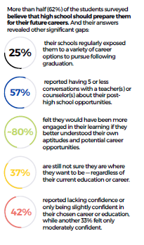
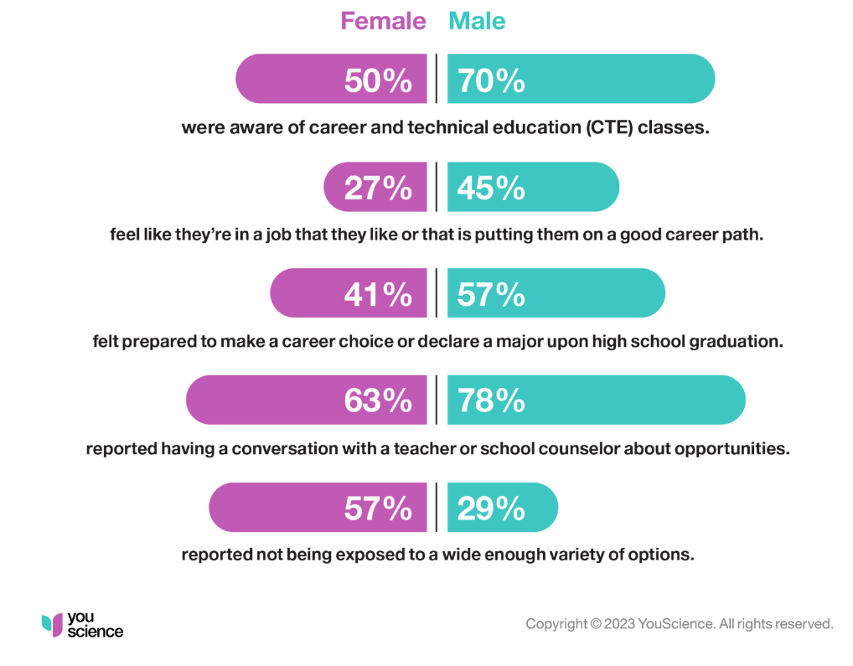
Appendix: National Survey of Recent High School Graduates
Survey Summary – All Students
Survey Findings – By Gender
Source: You Science National Survey findings (from 500 recently graduated high school students)

Slide 15
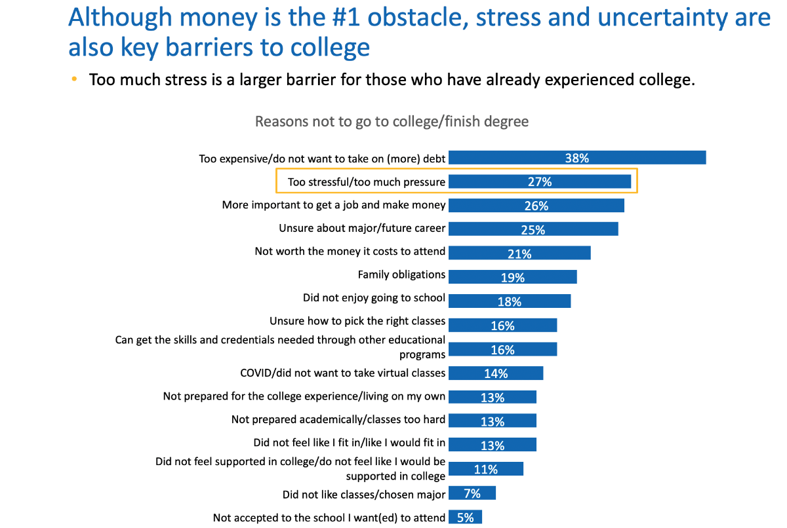
High School Student Post-secondary Plans cont’d.
Reasons why surveyed 18-30 year old's ended up not going to college or finishing their degree:
Source: HCM-EDGE Research “Where are the Students?”

Slide 16
High School Student Post-secondary Plans cont’d.
HCM-EDGE Research Process - 2022
Qualitative research – 11 focus groups with high school graduates ages 18-30 who did not pursue college or dropped out of a 2-year or 4-year college program.
Quantitative research – survey of 1,675 high school graduates in 7 target states (CA, FL, NY, OH, TN, TX and WA).
Statistical analysis of data and reporting.
Source: HCM-EDGE Research “Where are the Students?”

Slide 17
Appendix: Forthcoming Surveys, Reports and Research
Organization for Economic Cooperation and Development (OECD) Report – Final report in June 2023 includes a survey of Virginia secondary students with state, national and international comparison.
Ongoing discussions with VCU Douglas Wilder School of Government and Public Affairs, Survey and Evaluation Research Laboratory.

Slide 18
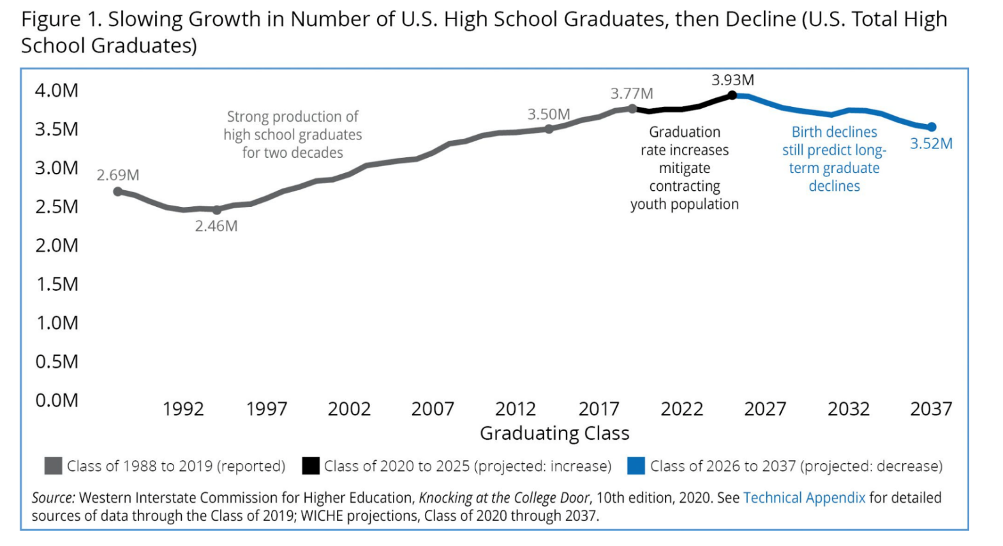
Appendix: National Enrollment “Cliff”
In all states the decline of high-school graduates from affluent families is projected to be higher than the overall decline. It is the affluent students who are sought after by universities as they recruit out-of-state students.
Notes:
These projections are used widely across a wide range of education stakeholders from policymakers to enrollment managers at the institutional level for short- and long-term planning in terms of capacity building and understanding who their future high school graduates are on college campuses.

Slide 19
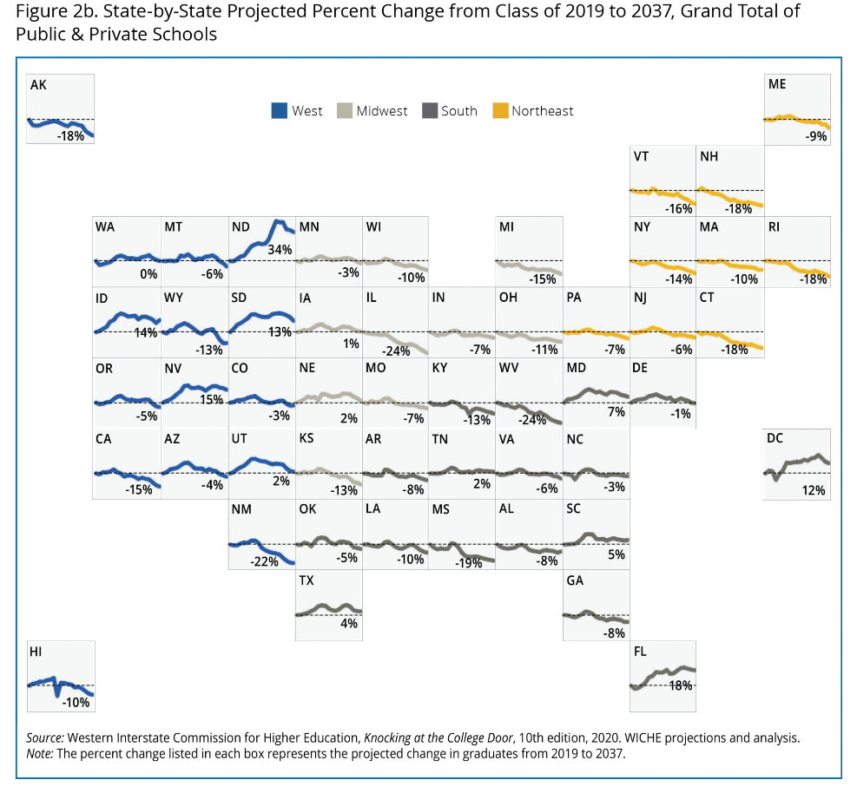
Appendix: Pipeline Projections

Slide 20
Appendix: Student College Choice Survey
Inside Higher Ed and College Pulse survey
Sample of 2,001 undergraduate students who are currently enrolled in the U.S.
The sample was drawn from College Pulse’s Undergraduate Student Panel that includes over 400,000 verified students representing more than 1,000 different colleges and universities in all 50 states. Panel members are recruited by a number of methods to help ensure diversity in the panel population, including web advertising, permission-based email campaigns, and partnerships with university organizations.
To reduce the effects of any non-response bias, a post-stratification adjustment was applied based on demographic distributions from the 2017 Current Population Survey (CPS). The post-stratification weight rebalanced the sample based on the following benchmarks: age, race and ethnicity, and gender. The sample weighting was accomplished using an iterative proportional fitting (IFP) process that simultaneously balances the distributions of all variables. Weights were trimmed to prevent individual interviews from having too much influence on the final results.
The margin of error for this survey is +/- 2.5%. Margins of error are typically calculated on probability-based samples and are not technically correct for non-probability online samples. We supply them here to provide a general assessment of error ranges that may be associated with the data.
This survey was fielded between February 23rd, 2022 and March 1st, 2022
For more information about our methodology, click here.
Source: Inside Higher Ed and College Pulse Student Voice survey

Slide 21
Appendix: Recent FAFSA Submission/Completion Rates
Free Application for Federal Student Aid (FAFSA) serves as an indicator for post-secondary plans.
FAFSA completions in Virginia are up this year compared to the previous year. This could be interpreted as a slightly greater interest in college by current high school seniors.
Virginia currently ranks 17th in the country at 38.9% completion of FAFSAs statewide. The national average is 37.3%.
Estimated FAFSA Totals in Virginia from February 3, 2022 through February 3, 2023
 | 2022 | 2023 | 2022 to 2023 Increase
Submitted | 39,772 | 42,052 | 2,280
Completed | 37,774 | 39,733 | 1,959
Source: Form Your Future and studentaid.gov

Slide 22
Appendix: Applications per Institution, 2012-2021
Source: SCHEV B08 Report
Notes:
In state FTIC admissions last 10 years.
Decrease in apps in 2020 – Covid-related
Sharp increase in apps due to common app (common application for most colleges and universities nationwide – complete main part once, then fill in specific per institution. Saves time.

Slide 23
Appendix: Institution Acceptance Rate Trends, 2012-2021
Source: SCHEV B08 Report
Notes:
More applications to colleges/universities translates to increased acceptance rates with exception of UVA, VT and W&M -

Slide 24
Appendix: Yield Rate by Institution, 2012-2021
Source: SCHEV B08 Report
Notes:
Yield rate is the percent of admitted students who decide to enroll. Increase in admissions because students applying to more schools equals increase in apps filed and increase in admissions but not actual people or enrolled students. i.e. one student applying to multiple schools can only choose one to accept and enroll.

Slide 25
Appendix: FTIC Cohort Retention Rate by Institution, 2012-2021
Source: SCHEV RT01 Report
Notes:
For most IHE, data are fairly consistent over time.

Slide 26
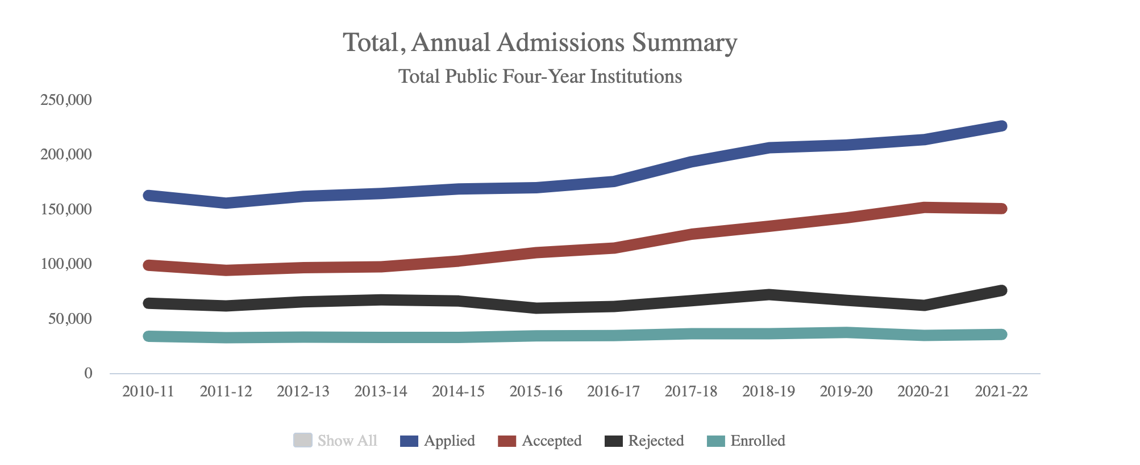
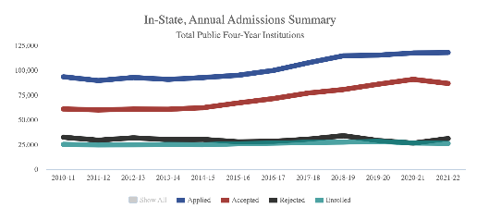
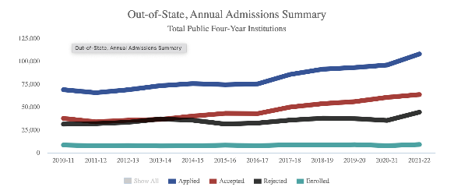
Appendix: Annual Admissions - FTIC
Source: SCHEV B08 Admissions Report

Slide 27
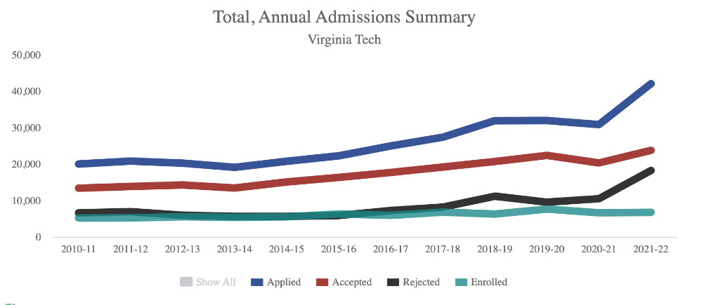
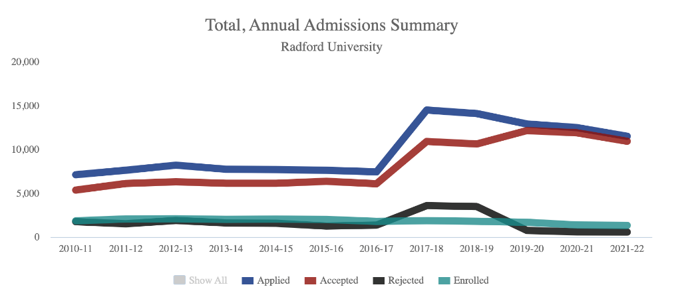
Annual Admissions (Sample) cont’d.
Source: SCHEV B08 Admissions Report

Slide 28
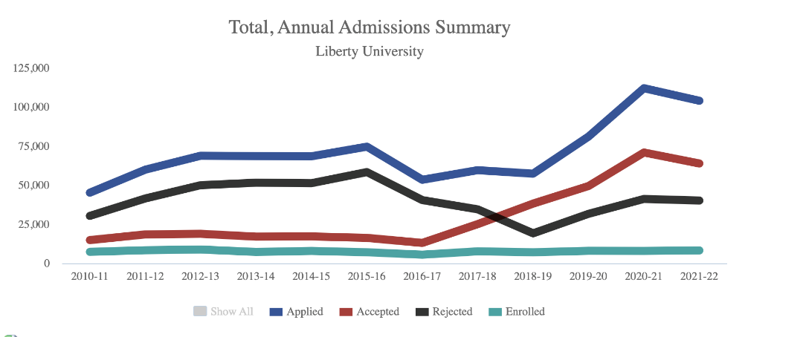
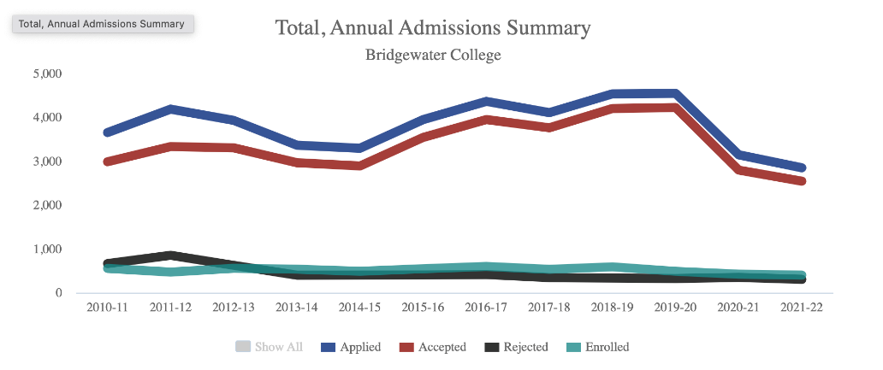
Annual Admissions (Sample) cont’d.
Source: SCHEV B08 Admissions Report

Slide 29
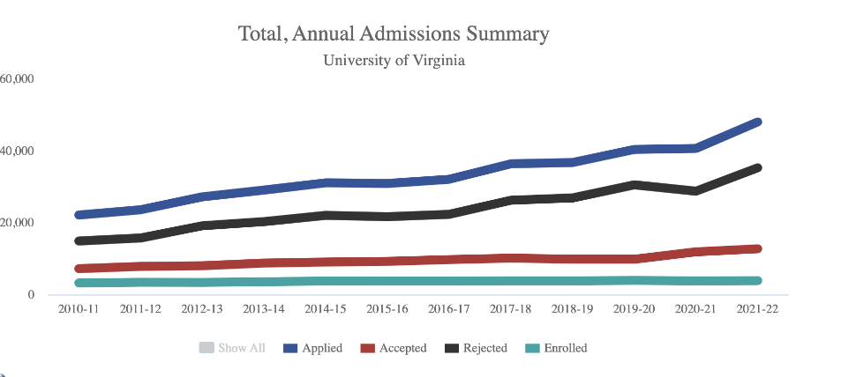
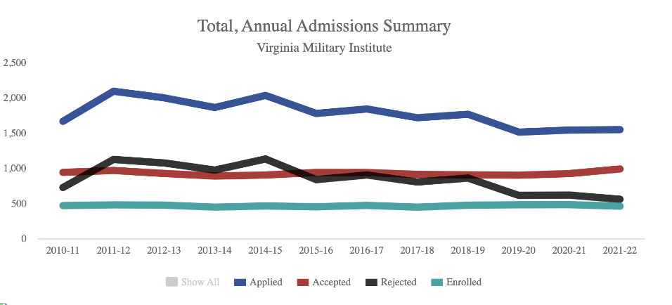
Annual Admissions (Sample) cont’d.
Source: SCHEV B08 Admissions Report

Slide 30
Appendix: College Enrollment Rate – High School Graduates
Source: VDOE C11 Report. Graduates of Virginia high schools who enrolled in a post-secondary program within 16 months.

Slide 31
Appendix: Disaggregated Virginia Enrollment Data
Enrollment: Fall headcount of public and private undergraduates.
The following enrollment gaps exist where enrollment does not reflect the population:
By race/ethnicity: Black; Hawaiian Islander/Pacific Islander; Non-Resident Alien; and White – all unchanged from 2019-2020.
By region of origin: Hampton Roads and Shenandoah Valley – both unchanged from 2019-2020, as well as Richmond – new this year.
By income: Middle income – unchanged from 2019-2020.
By gender: Male – unchanged from 2019-2020.
Source: SCHEV Pathways to Opportunity Plan Progress Tracker

Slide 32
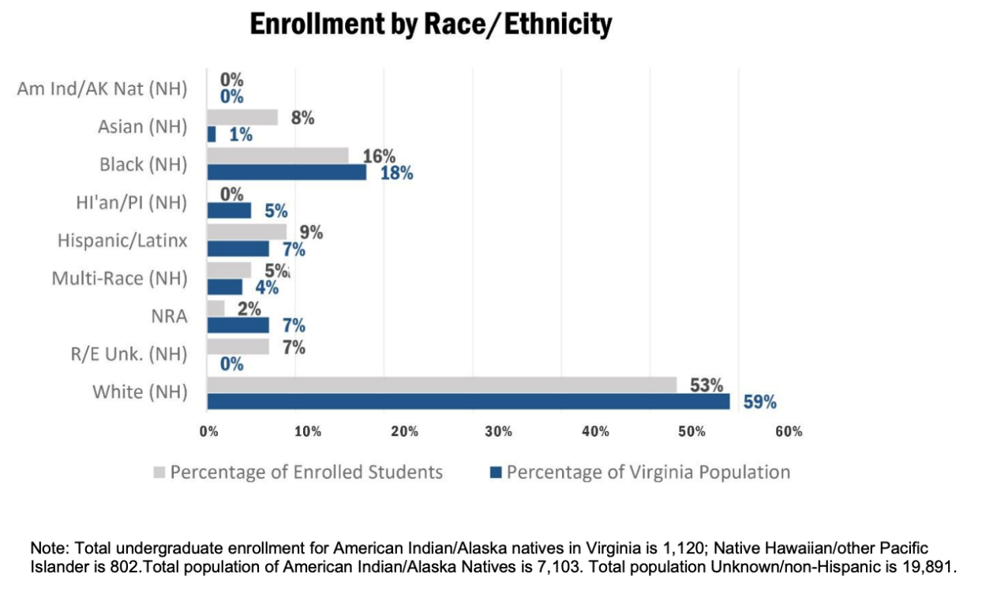
Disaggregated Virginia Enrollment Data – Race/Ethnicity
By race/ethnicity: Black; Hawaiian Islander/Pacific Islander; Non-Resident Alien; and White – all unchanged from 2019-2020.
Source: SCHEV Pathways to Opportunity Plan Progress Tracker

Slide 33
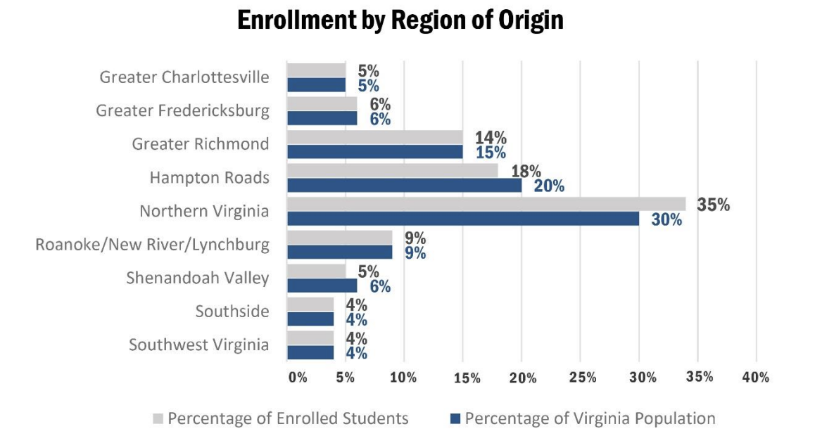
Disaggregated Virginia Enrollment Data – Region of Origin
By region of origin: Hampton Roads and Shenandoah Valley – both unchanged from 2019-2020, as well as Richmond – new this year.
Source: SCHEV Pathways to Opportunity Plan Progress Tracker

Slide 34
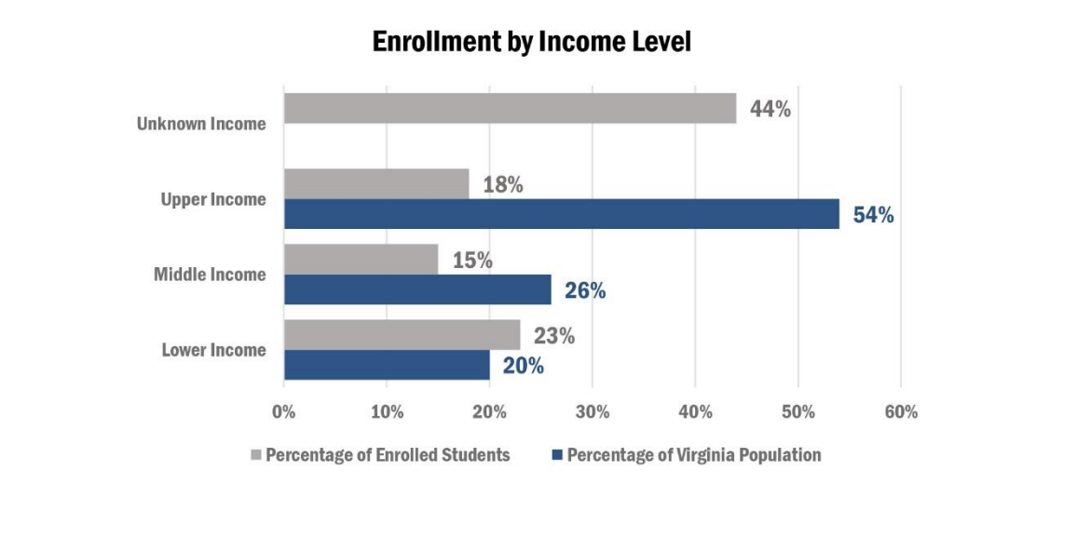
Disaggregated Virginia Enrollment Data - Income
By income: Middle income – unchanged from 2019-2020.
Source: SCHEV Pathways to Opportunity Plan Progress Tracker

Slide 35
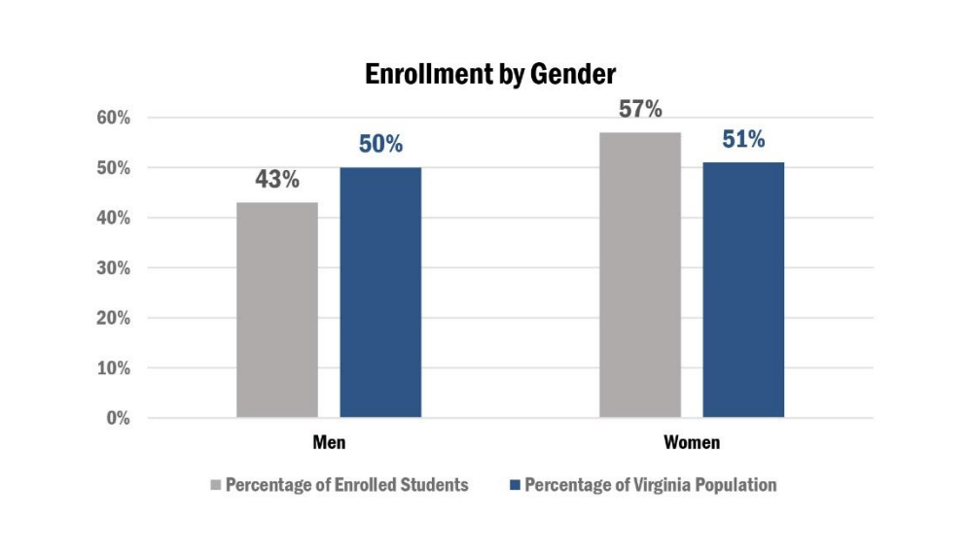
Disaggregated Virginia Enrollment Data - Gender
By gender: Male – unchanged from 2019-2020
Source: SCHEV Pathways to Opportunity Plan Progress Tracker

Slide 36
Appendix: Where are Virginians Going to College?
Where are Virginians going to college? - 2010 | Top 10 Out-of-State Destinations for All FTIC Virginia Residents 2020 | Top 10 Out-of-State Destinations for All FTIC Virginia Residents 2020 | Top 10 Out-of-State Destinations for All FTIC Virginia Residents 2020
Rank | State | Number | % of Total
- | Virginia | 45,982 | 80.98%
1 | North Carolina | 1,851 | 3.26%
2 | Pennsylvania | 1,068 | 1.88%
3 | West Virginia | 828 | 1.46%
4 | New York | 746 | 1.31%
5 | South Carolina | 658 | 1.16%
6 | Florida | 519 | 0.91%
7 | Maryland | 454 | 0.80%
8 | District of Columbia | 445 | 0.78%
9 | Tennessee | 424 | 0.75%
10 | Georgia | 365 | 0.64%
- | All Other States | 3,441 | 6.06%
Where are Virginians going to college? - 2020 | Top 10 Out-of-State Destinations for All FTIC Virginia Residents 2020 | Top 10 Out-of-State Destinations for All FTIC Virginia Residents 2020 | Top 10 Out-of-State Destinations for All FTIC Virginia Residents 2020
Rank | State | Number | % of Total
- | Virginia | 47,272 | 80.27%
1 | North Carolina | 1,316 | 2.23%
2 | Pennsylvania | 1,278 | 2.17%
3 | New York | 869 | 1.48%
4 | South Carolina | 740 | 1.26%
5 | Tennessee | 578 | 0.98%
6 | West Virginia | 578 | 0.98%
7 | Florida | 555 | 0.94%
8 | District of Columbia | 519 | 0.88%
9 | Maryland | 499 | 0.85%
10 | Ohio* | 417 | 0.71%
- | All Other States | 4,273 | 7.26%
Note: Only includes first-time in college students who graduated high school within 12 months of enrolling
Source: IPEDS

Slide 37
Appendix: Top Out-of-State Destinations for Virginia Residents
Top 10 Out-of-State Destinations for All FTIC Virginia Residents 2010 | Top 10 Out-of-State Destinations for All FTIC Virginia Residents 2020 | Top 10 Out-of-State Destinations for All FTIC Virginia Residents 2020 | Top 10 Out-of-State Destinations for All FTIC Virginia Residents 2020
Rank | Institution | Number of Students | State
1 | West Virginia University | 372 | WV
2 | University of Phoenix | 278 | AZ
3 | American Intercontinental University | 215 | IL
4 | East Carolina University | 209 | NC
5 | University of South Carolina-Columbia | 161 | TN
6 | Chowan University | 152 | NC
7 | Western International University | 138 | AZ
8 | Elon University | 114 | NC
9 | Brigham Young University | 112 | UT
10 | Shepherd University | 110 | WV
Top 10 Out-of-State Destinations for All FTIC Virginia Residents 2020 | Top 10 Out-of-State Destinations for All FTIC Virginia Residents 2020 | Top 10 Out-of-State Destinations for All FTIC Virginia Residents 2020 | Top 10 Out-of-State Destinations for All FTIC Virginia Residents 2020
Rank | Institution | Number of Students | State
1 | The Pennsylvania State University | 371 | PA
2 | West Virginia University | 315 | WV
3 | Southern New Hampshire University | 266 | NH
4 | University of South Carolina-Columbia | 238 | SC
5 | The University of Tennessee-Knoxville | 215 | TN
6 | Clemson University | 155 | SC
7 | George Washington University | 150 | DC
8 | East Carolina University | 144 | NC
9 | University of Pittsburgh-Pittsburgh Campus | 139 | PA
10 | Brigham Young University | 135 | UT
Source: IPEDS

Slide 38
Appendix: Where are Students in Virginia Coming From?
Where are Students in Virginia coming from? - 2010 | Top 10 Out-of-State Destinations for All FTIC Virginia Residents 2020 | Top 10 Out-of-State Destinations for All FTIC Virginia Residents 2020 | Top 10 Out-of-State Destinations for All FTIC Virginia Residents 2020
Rank | State | Number | % of Total
- | Virginia | 45,982 | 77.58%
1 | Maryland | 2,340 | 3.95%
2 | New Jersey | 1,323 | 2.23%
3 | Pennsylvania | 1,289 | 2.17%
4 | North Carolina | 1,069 | 1.80%
5 | New York | 965 | 1.63%
6 | Foreign countries | 763 | 1.29%
7 | State unknown | 621 | 1.05%
8 | Florida | 418 | 0.71%
9 | Massachusetts | 411 | 0.69%
10 | Connecticut | 359 | 0.61%
- | All Other States | 3,729 | 6.29%
Where are Students in Virginia coming from? – 2020 | Top 10 Out-of-State Destinations for All FTIC Virginia Residents 2020 | Top 10 Out-of-State Destinations for All FTIC Virginia Residents 2020 | Top 10 Out-of-State Destinations for All FTIC Virginia Residents 2020
Rank | State | Number | % of Total
- | Virginia | 47,272 | 78.14%
1 | Maryland | 1,770 | 2.93%
2 | North Carolina | 1,376 | 2.27%
3 | Pennsylvania | 1,282 | 2.12%
4 | New Jersey | 1,262 | 2.09%
5 | New York | 942 | 1.56%
6 | Foreign countries | 511 | 0.84%
7 | Florida | 496 | 0.82%
8 | Texas* | 443 | 0.73%
9 | Georgia* | 424 | 0.70%
10 | California* | 398 | 0.66%
- | All Other States | 4,317 | 7.14%
Note: Only includes first-time in college students who graduated high school within 12 months of enrolling
Source: IPEDS

Slide 39
Appendix: Sample Data of Accepted Students that Enroll Elsewhere
Key Takeaways:
In-state and out-of-state enrollment impact enrollment at Virginia’s higher education institutions in different but important ways.
In the case of JMU data, JMU’s biggest competitor is in-state, Virginia Tech. For example, in 2021, 540 students who were accepted at JMU enrolled at Virginia Tech. UVA data suggest that many of its biggest competitors are out-of-state (i.e., Notre Dame, George Tech, etc.).
Sources: JMU survey of non-enrolling students and UVA-specific data from National Student Clearinghouse.

Slide 40
Sample Data of Accepted Students that Enroll Elsewhere, cont’d.
JMU-Accepted Students Who Enrolled Elsewhere, 2019-2020
School Choice | Total | 2019 | 2020 | 2021
Virginia Tech | 2030 | 758 | 732 | 540
University of Virginia | 717 | 276 | 270 | 171
Pennsylvania State University | 501 | 155 | 172 | 174
Virginia Commonwealth Univ | 339 | 154 | 83 | 102
George Mason University | 294 | 103 | 99 | 92
University of Delaware | 291 | 71 | 101 | 119
Christopher Newport University | 233 | 93 | 81 | 59
University of Maryland | 225 | 75 | 67 | 83
University of South Carolina | 195 | 53 | 64 | 78
College of William & Mary | 185 | 49 | 67 | 69
Clemson University | 156 | 47 | 50 | 59
Elon University | 109 | 37 | 43 | 29
Old Dominion University | 86 | 27 | 36 | 23
University of Pittsburgh Main | 85 | 11 | 24 | 50
University of Tennessee | 83 | 16 | 23 | 44
Indiana University Bloomington | 74 | 17 | 21 | 36
University of North Carolina | 74 | 17 | 27 | 30
Syracuse University | 73 | 19 | 20 | 34
West Virginia University | 65 | 30 | 15 | 20
UVA-Accepted Students Who Enrolled Elsewhere, 2022
School Choice, Fall 2022 | College State | Public / Private
Enrollment Not Reported to NSC
UNIVERSITY OF NOTRE DAME | IN | Private
VIRGINIA POLYTECH & STATE UNIV | VA | Public
GEORGIA INSTITUTE OF TECHNOLOGY | GA | Public
GEORGETOWN UNIVERSITY | DC | Private
UNIVERSITY OF MICHIGAN | MI | Public
DUKE UNIVERSITY | NC | Private
UNIVERSITY OF PENNSYLVANIA | PA | Private
CORNELL UNIVERSITY | NY | Private
PRINCETON UNIVERSITY | NJ | Private
UNIVERSITY OF NORTH CAROLINA-CHAPEL HILL | NC | Public
UNIVERSITY OF CALIFORNIA - BERKELEY | CA | Public
UNIVERSITY OF MARYLAND - COLLEGE PARK | MD | Public
YALE UNIVERSITY | CT | Private
UNIVERSITY OF SOUTHERN CALIFORNIA | CA | Private
HARVARD UNIVERSITY | MA | Private
UNIVERSITY OF CALIFORNIA-LOS ANGELES | CA | Public
WILLIAM & MARY | VA | Public
BROWN UNIVERSITY | RI | Private
Sources: JMU survey of non-enrolling students and UVA-specific data from National Student Clearinghouse.

Slide 41
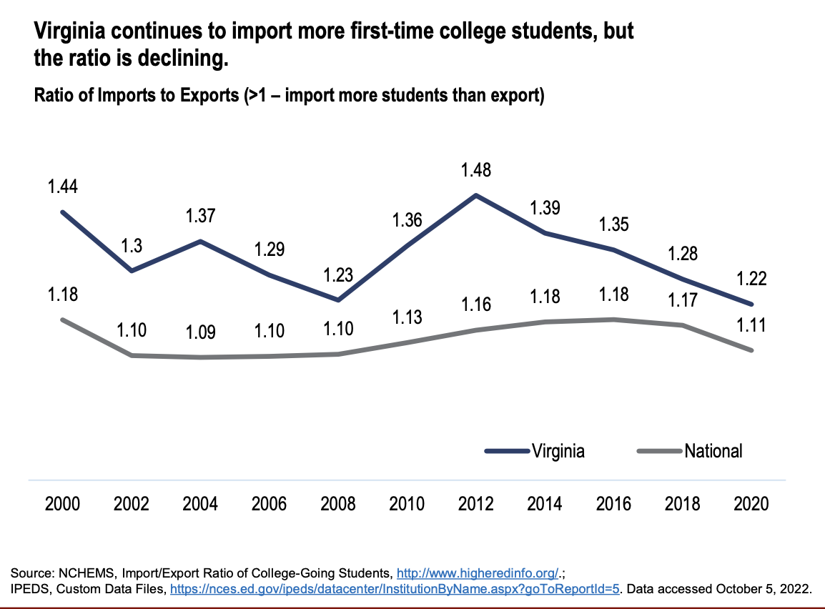
Appendix: Competition for College Students
Source: Senate Finance and Appropriations Committee Education Enrollment presentation, November, 19, 2022.

Slide 42
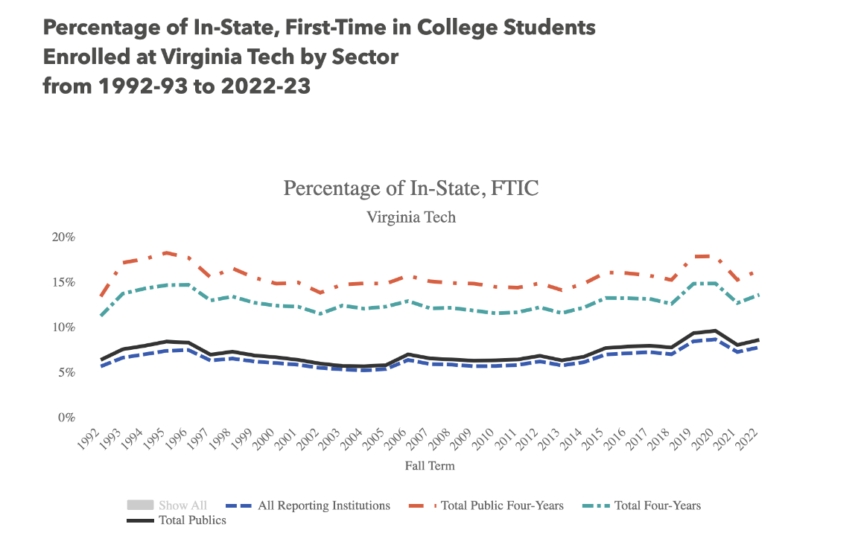
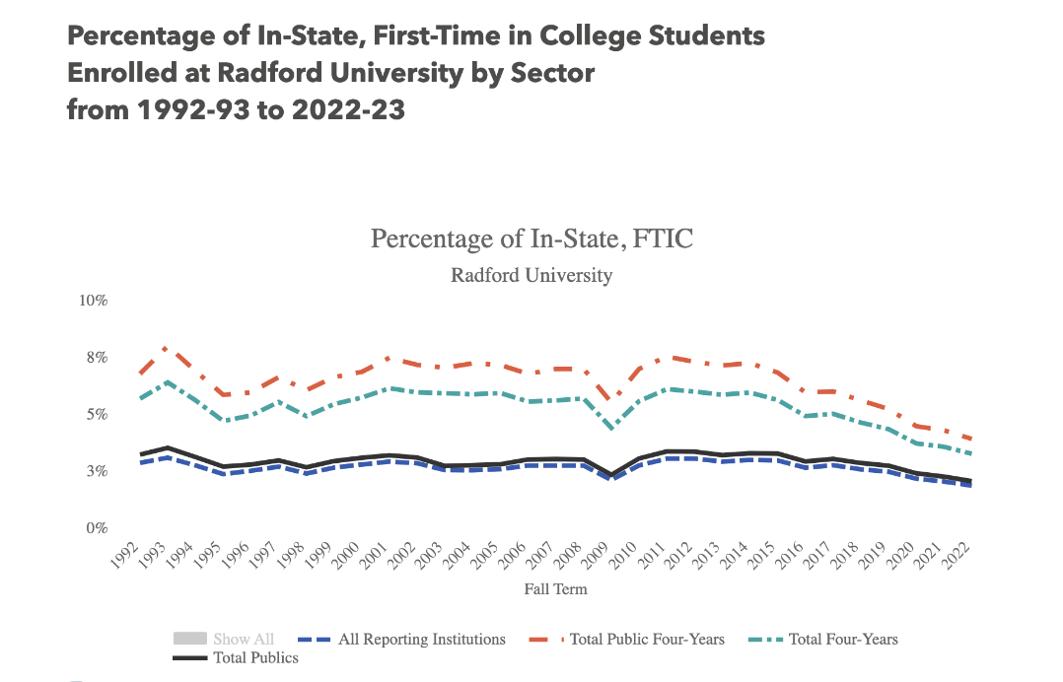
Appendix: In-State, FTIC over Time (Sample)
Source: SCHEV Trends in the Percentage of New Enrollment by Student Type and Institution (E48 Report)

Slide 43
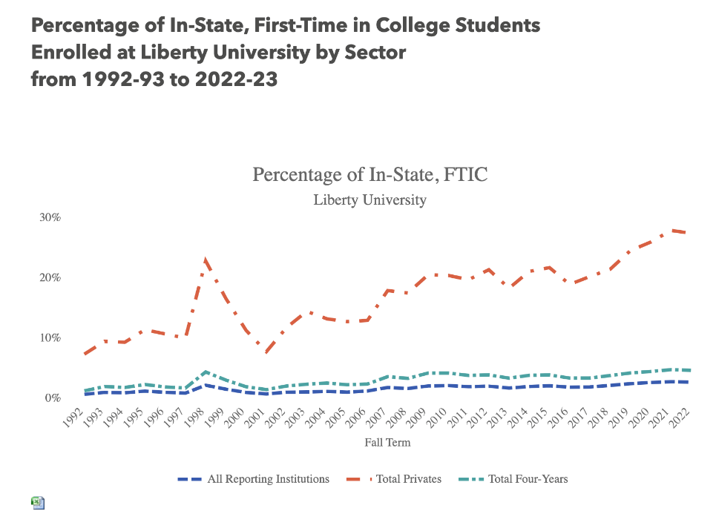
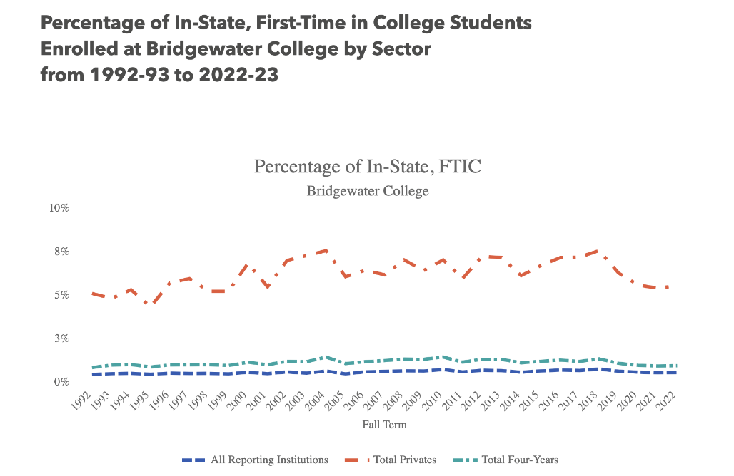
In-State, FTIC over Time (Sample) cont’d.
Source: SCHEV Trends in the Percentage of New Enrollment by Student Type and Institution (E48 Report)

Slide 44
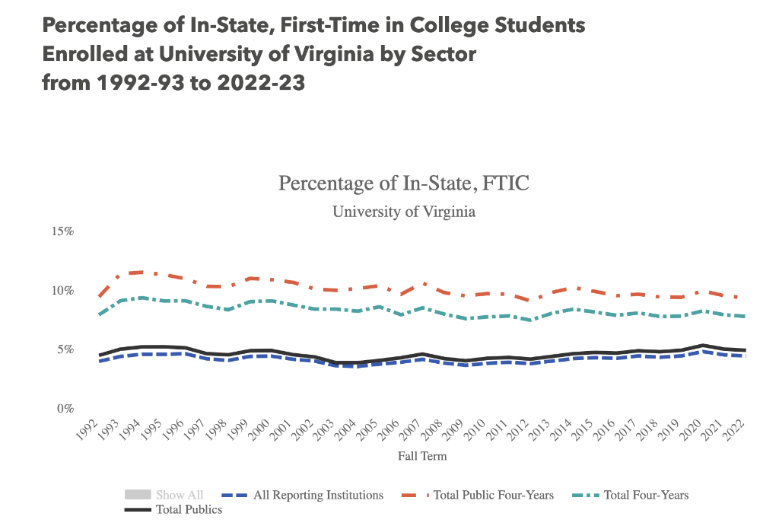
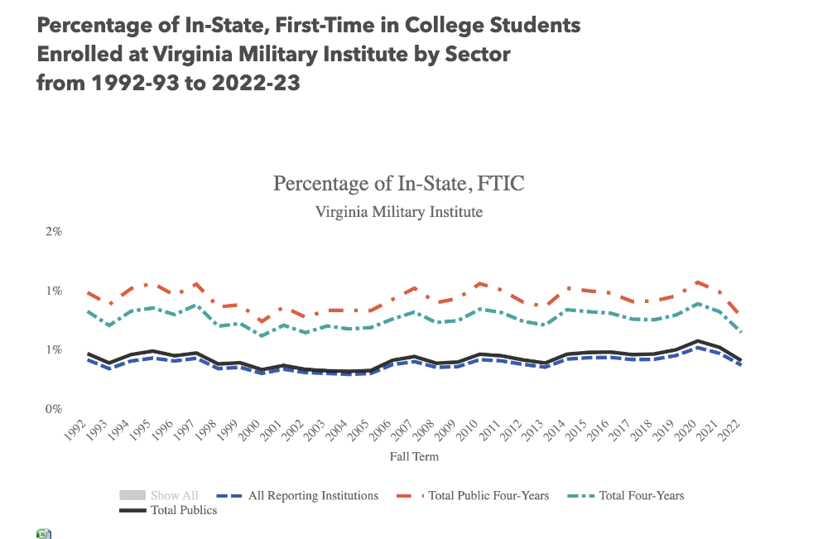
In-State, FTIC over Time cont’d.
Source: SCHEV Trends in the Percentage of New Enrollment by Student Type and Institution (E48 Report)

Slide 45
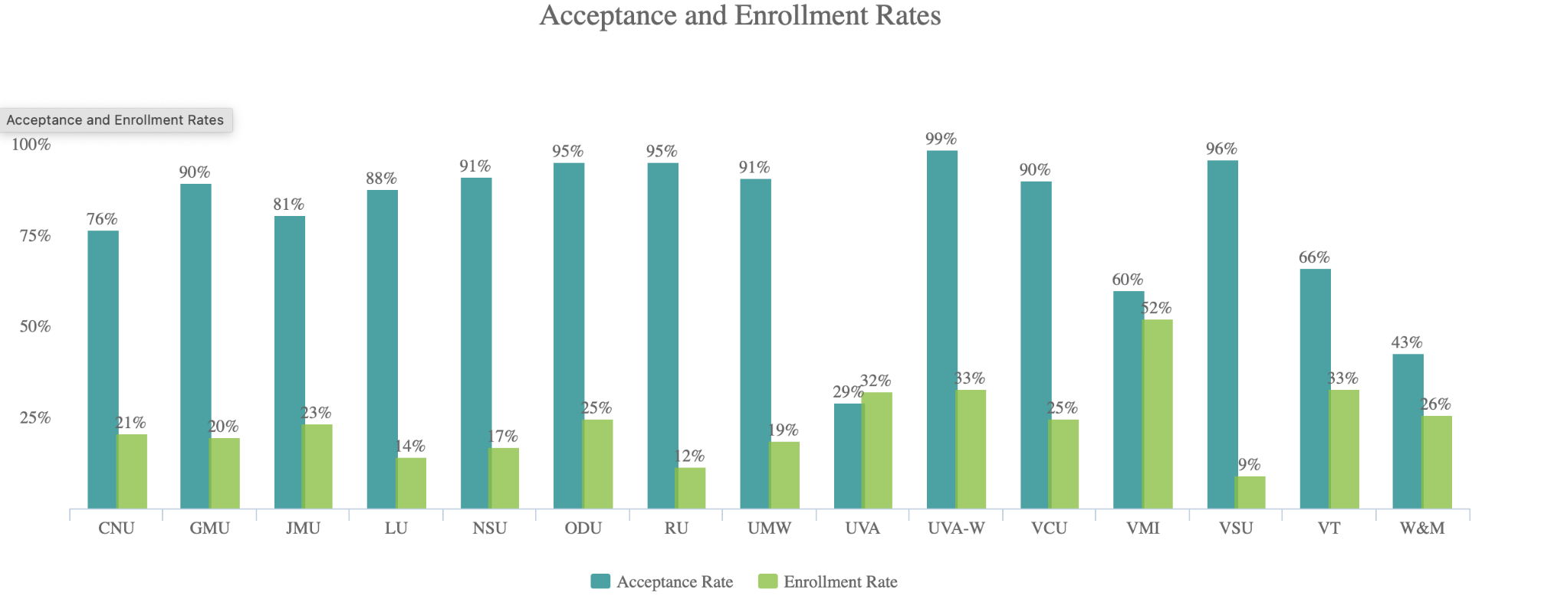
Appendix: Acceptance & Enrollment – 2020-21
The percentage of the students who applied for and were offered first-time undergraduate admission.
Source: SCHEV Public Higher Education Transparency in Virginia

Slide 46
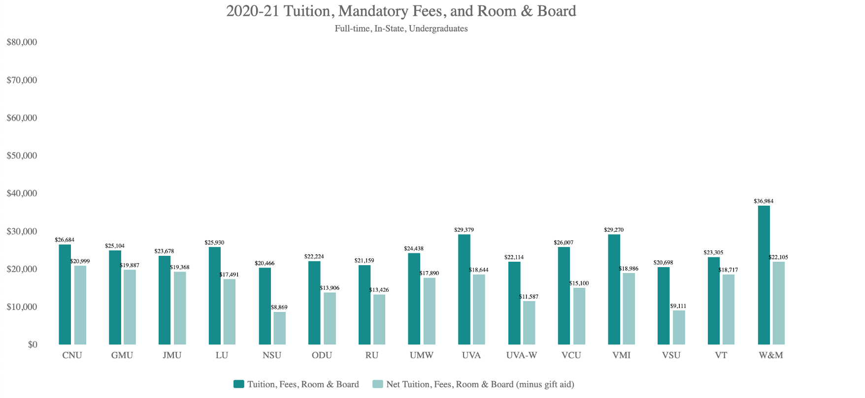
Appendix: Tuition and Fees – 2020-21
The average and net annual total tuition and fees and room and board for a full-time undergraduate student living on campus.
Source: SCHEV Public Higher Education Transparency in Virginia

Slide 47
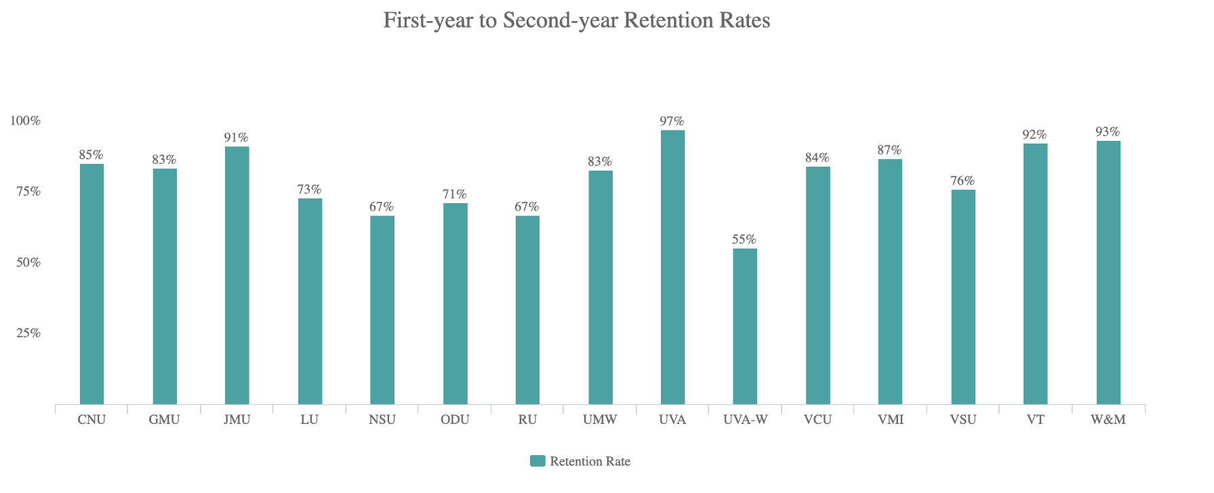
Appendix: First to Second Year Retention Rates – 2020-21
The first year to second year retention rates for full-time undergraduate students.
Source: SCHEV Public Higher Education Transparency in Virginia

Slide 48
Appendix: K-12 Efforts to Improve Education Relevancy
Key approaches – Example from Washington state
Mastery-based learning work group. This group identified barriers to mastery-based learning and explored ways to increase student access to relevant and robust mastery-based academic pathways aligned to personal career and postsecondary goals.

Slide 49
Appendix: Institutional Efforts to Increase Enrollment
Key approaches
Targeted scholarships, grants and other supports for under-served students.
Piedmont Scholars Program for Transfers - PVCC
Promise Scholars – W&M and RBC
Centennial Scholars Program - JMU
Improved financial aid communication and simplified processes.
UVA and VMI
Community/high school/student outreach: student-to-student connections and VACRAO Virginia Tour.
Targeted high school outreach by students – VMI
Targeted outreach to existing students who aren’t registered and not graduating – Longwood and UMW

Slide 50
Institutional Efforts cont’d.
Key approaches
College prep and summer bridge programs.
Community Captains – CNU
Valley Scholars Program – JMU (prep program with scholarships based on completion)
New River Community College/Radford University summer bridge program
Hispanic College Institute and Black College Institute – VT academic summer enrichment programs
First Generation Program: Sneak Peek – VT
Alternative growth/counterbalance strategies.
Growing graduate programs to counterbalance decreased undergraduate enrollment – Longwood
Target non-traditional students and adult learners – Radford
Strengthen existing services/student persistence.
Centralized advising for first year students –Radford
Reformat general education to streamline degree completion, reduce redundant credits
Credential student expertise and skill – General recommendation
Strategic recruitment planning.
Strategic recruitment plan and brand awareness campaign - UMW

Slide 51
Appendix: Potential State Program Considerations
Student-focused supports via statewide programming and resources
Scale up models such as VCAC and GUV
Invest in FAFSA completion efforts
Outreach and shared data
Consider alternatives to College Board for outreach and student contact information
Provide VCCS with HS directory information and address for automatic acceptance to local community college

Slide 52
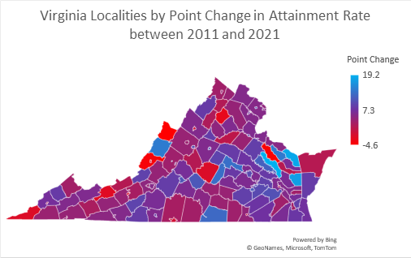
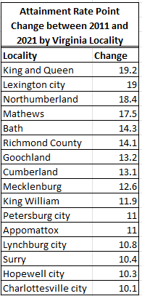
Appendix: 2011-2021 Attainment Rate Point Change by Locality
Source: Lumina Foundation.

