Slide 1
Discussion of Cost and Funding Needs Study
SCHEV Council Meeting
Resources and Planning Committee
July 19, 2022
Tom Allison & Wendy Kang

Slide 2
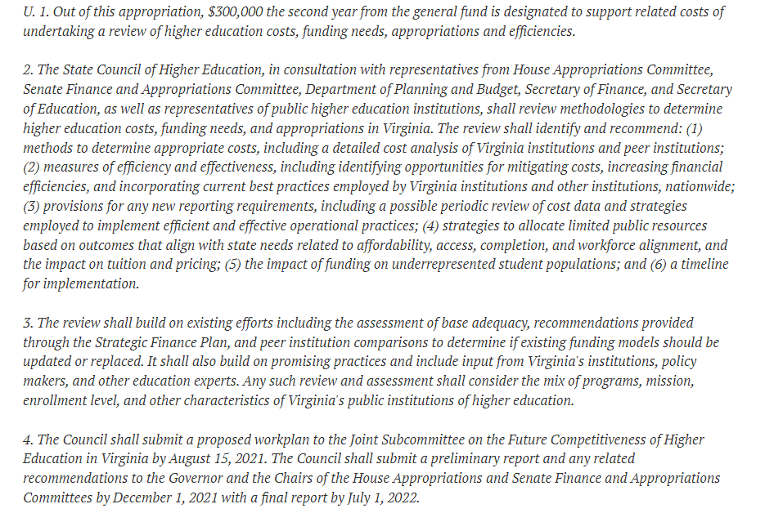
Background
In 2021, the General Assembly directed SCHEV to study higher education costs and funding needs of the Commonwealth’s public institutions.
Methods to determine appropriate costs (including peer institutions).
Measures of efficiency and effectiveness.
Provisions for any new reporting requirements.
Strategies to allocate limited public resources based on outcomes that align with state needs.
Impact of funding on underrepresented student populations; and
a timeline for implementation.

Slide 3
Background
Inside Scope of Study
Education and General (E&G) operating
Education
Research
Public Service
Academic Support
Student Services
Institutional Support
Operation & Maintenance of Plant
Outside Scope of Study
Auxiliaries (e.g., housing, bookstore operations, athletics)
Capital Budgets
Financial Aid
Endowments

Slide 4
Background
SCHEV, in consultation with the Op-Six staff members issued a Request for Proposals (RFP) in May 2021 and subsequently awarded the contract to the National Center for Higher Education Management Systems (NCHEMS), a private, non-profit 501(c)(3) organization headquartered in Boulder, Colorado, with extensive experience in state postsecondary finance policy.
SCHEV formed working groups to inform project. The Op-Six workgroup and selected institutional finance officers contributed the most feedback and guidance.
Maintained a webpage with relevant materials for public review.
www.schev.edu/coststudy

Slide 5
Background
Four Deliverables
Review of funding policies
Efficiency & effectiveness Review
Trends in costs
Recommendation for a new funding model

Slide 6
Deliverable 1: Review of Funding Policies
Conducted 50-state survey of how other states fund their systems.
Most states, including Virginia, use a “Base Plus” approach where new spending is added to previous year’s funding.
Formulas are a better basis for rational and strategic funding approaches.
Virginia’s current base funding formula no longer serves as a strategic and rational mechanism for resource allocation.

Slide 7
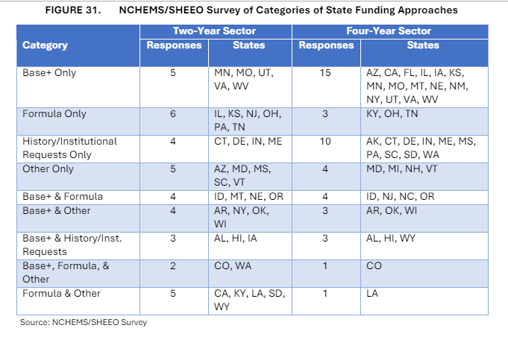

Slide 8
Deliverable 2: Efficiency & Effectiveness
Fielded survey to public institutions on efforts to improve efficiency and effectiveness and their impact.
Virginia institutions are active in seeking efficiencies.
Concentrated in internal strategies (org structure, program realignment, purchasing contracts, energy etc.)
Efforts between institutions are more rare.
Need to establish metrics and routinize them.
Revenue per degree
Degrees per FTE
Expenditures per FTE

Slide 9
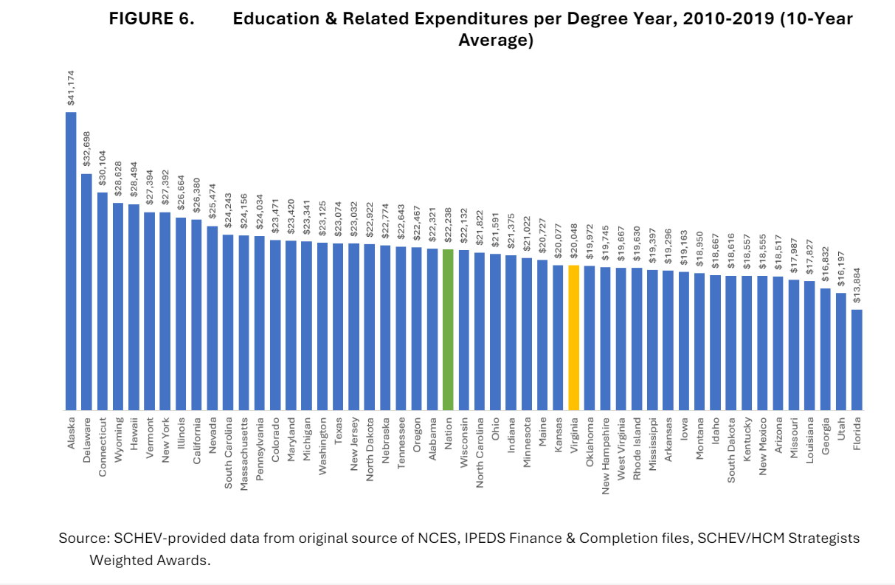

Slide 10
Deliverable 3: Trends in costs and funding
Virginia’s total education revenue per student nearly identical to the national median.
State appropriations per student: 38th
Tuition revenue per student: 18th
State funding volatile since recession
Two-year sector has recovered.
Four-year sector still down 16% since FY 2019.
NCHEMS selected Peer groups based on programs offered, size, and mission.
VA intuitions spend more per student than peer average (less on E&G, and more on auxiliaries).
More work necessary on peer selections and applications.

Slide 11
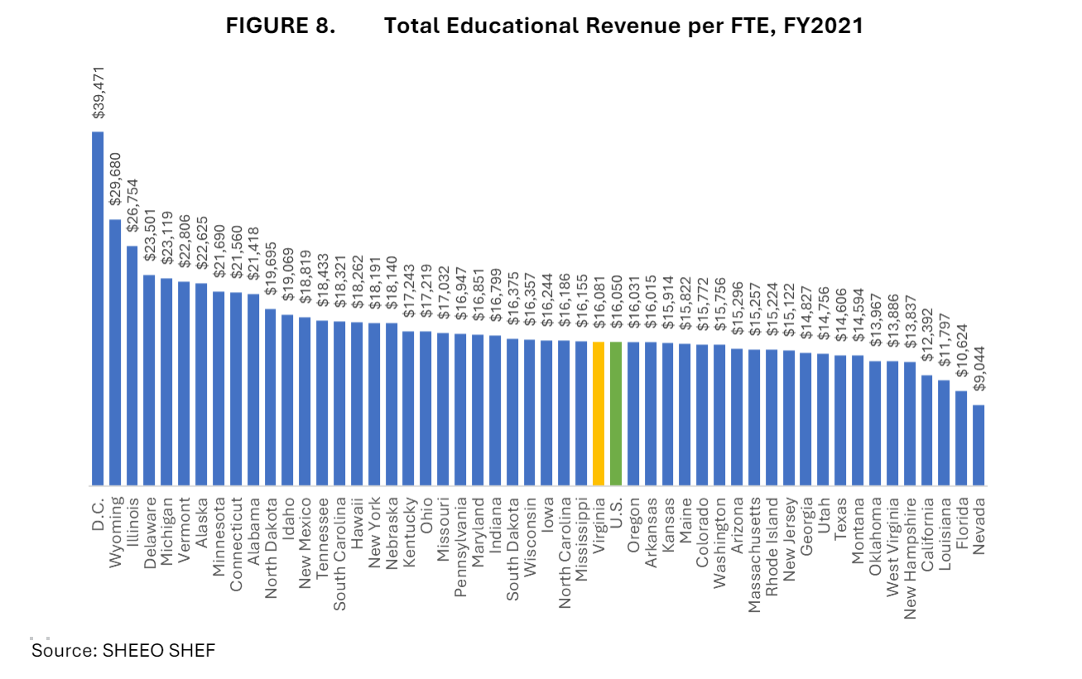

Slide 12
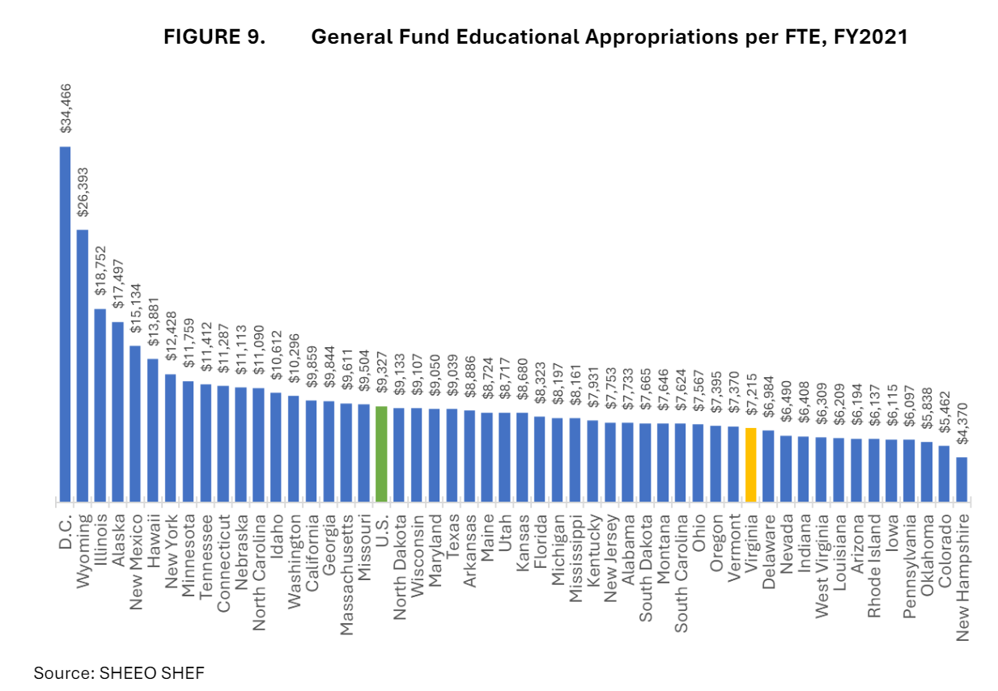

Slide 13
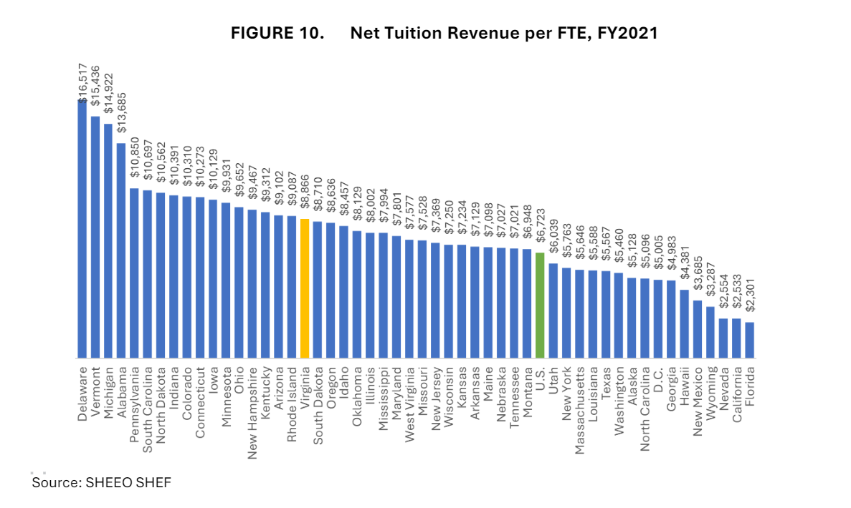

Slide 14
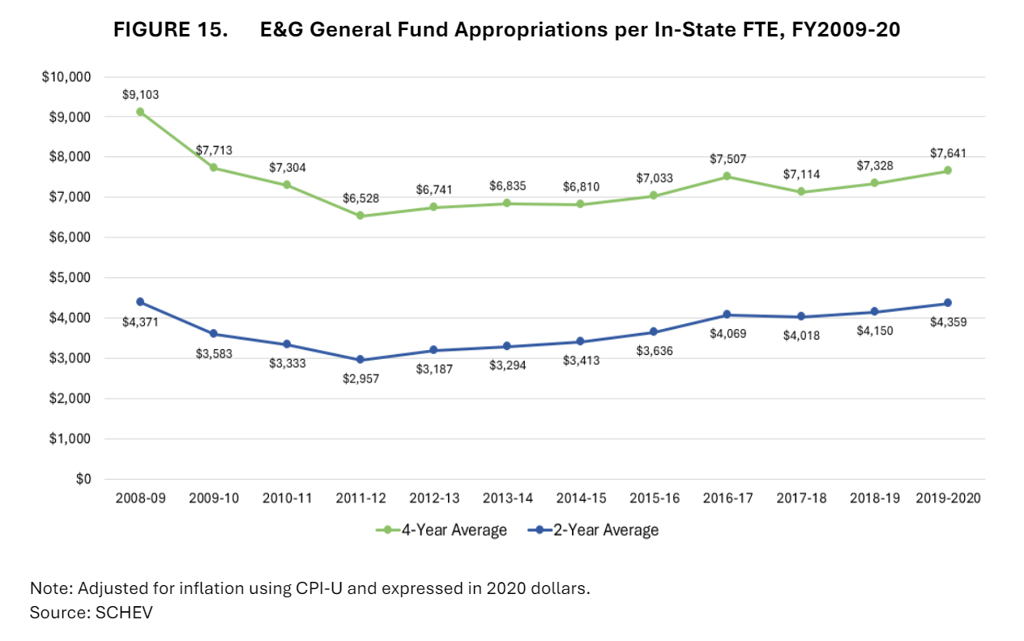

Slide 16
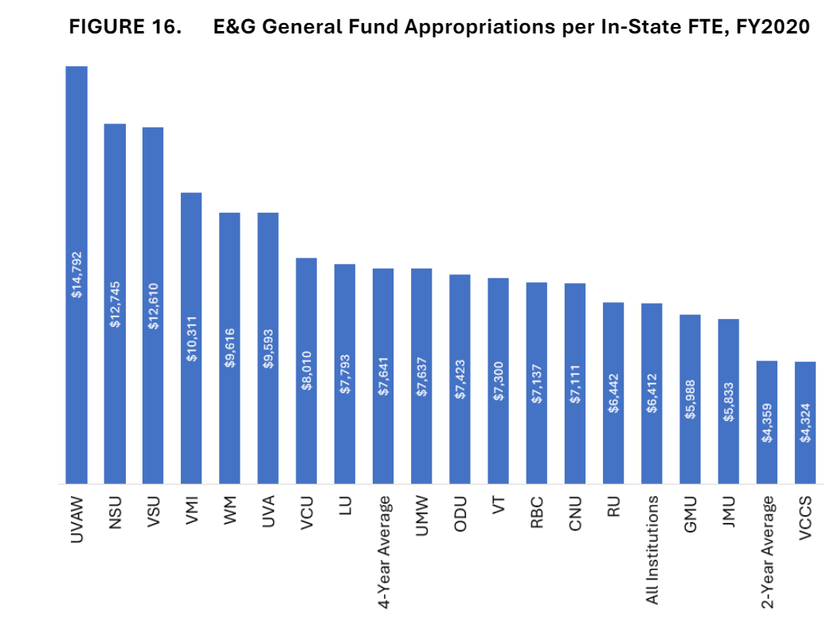

Slide 17
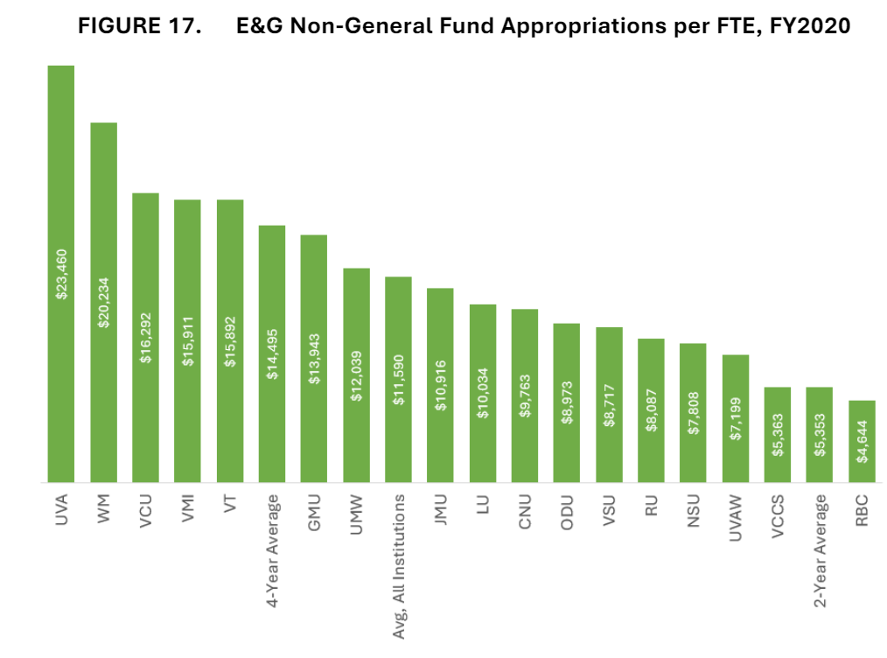

Slide 18
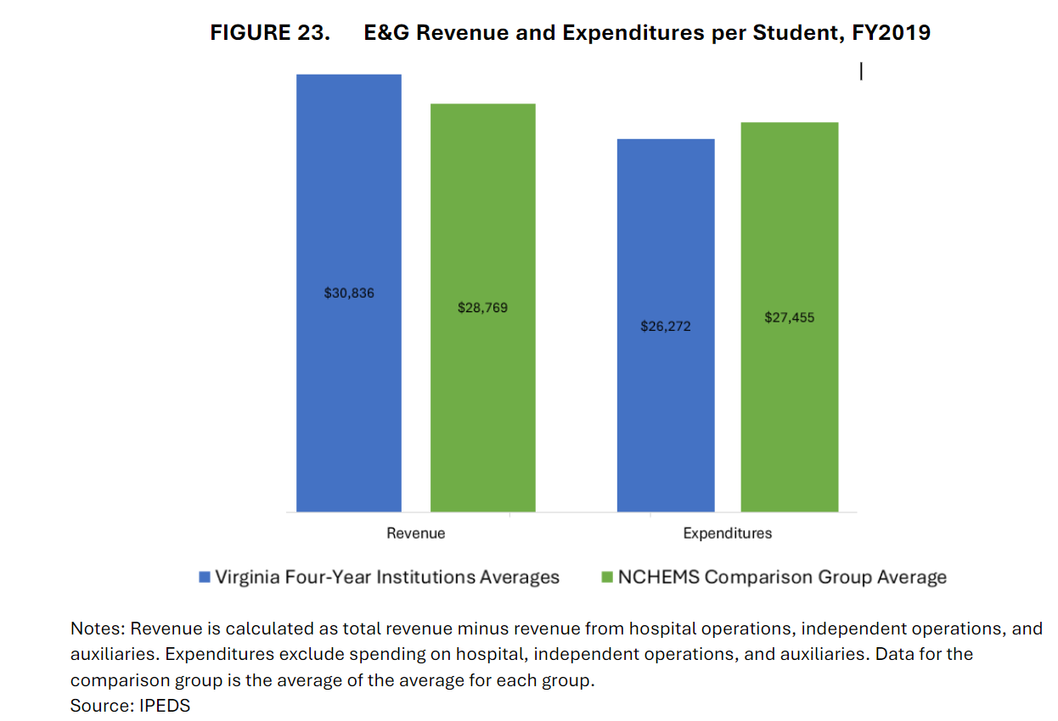

Slide 19
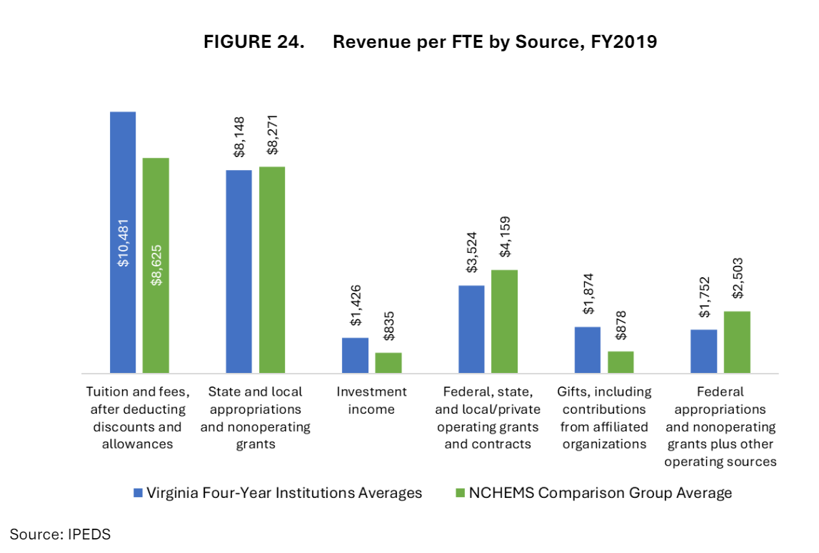

Slide 20
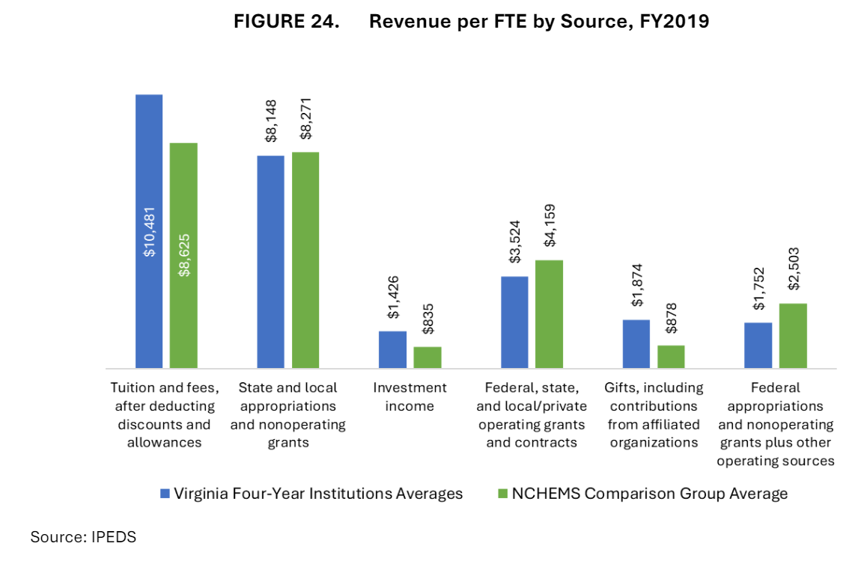

Slide 21
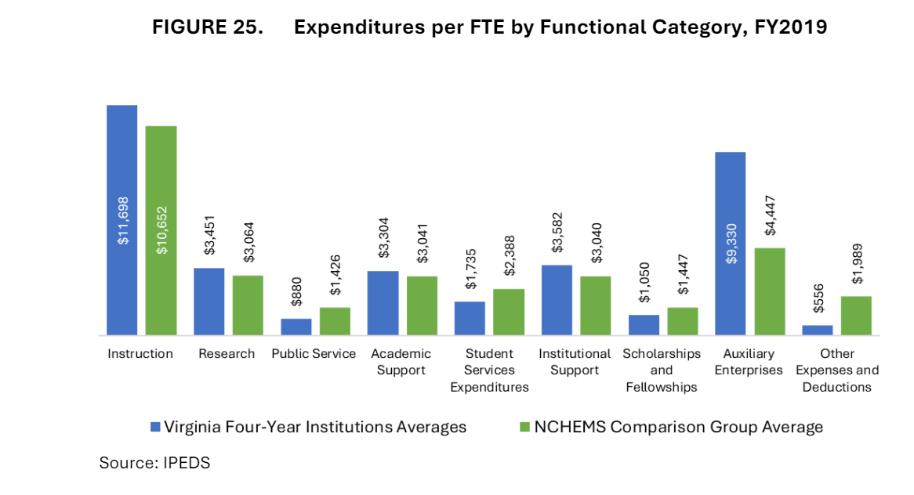

Slide 22
Deliverable 4: New funding model
Principles of Design & Implementation
Conceptual framework establishes components of costs.
“Frugal” foundational funding
Presentative maintenance
Scale & Scope
Audience
Performance / Incentives
Capacity Building
State purchase of “good and services” (state research, noncredit offerings, community service etc.)
More work necessary to define and operationalize these components.

Slide 23
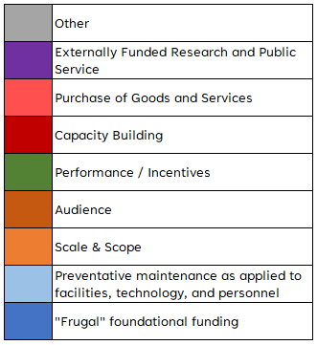
Taxonomy of Institutional Costs

Slide 24
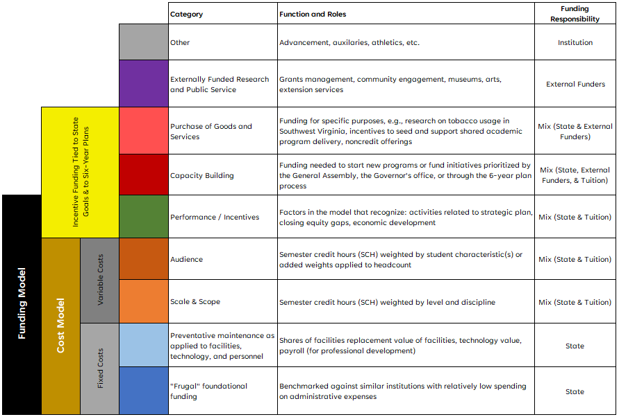
Institutional Funding Adequacy Framework

Slide 25
Recommendations (abridged)
Adopt conceptual framework.
Adopt differential cost-sharing targets.
Implement an incentives and performance component of the conceptual framework that rewards institutions for making progress toward state goals.
Implementation Plan for finalizing model.
Operationalize model by defining components
Refine selection and use of peer groups.
Establish metrics of efficiency & effectiveness.

Slide 26
Proposed Implementation Plan
July 1: Report published
July: SCHEV develops implementation plan
Septembe: SCHEV recreates NCHEMS’ model w/ updated data.
July: SCHEV distributes’ peer analysis packet.
August: Recurring meetings with Op-Six workgroup.
August: Reach working compromise w/ Op-Six workgroup on model parameters.
August : 1-on-1 meetings with institutions to discuss selection and use of peers.
September: Revisions and additions to peer groups.
Spring 2023: Institutional technical workgroups review model.
July 2023: Finalize model parameters for use in 2025-26 budget cycle.

